Slide 1
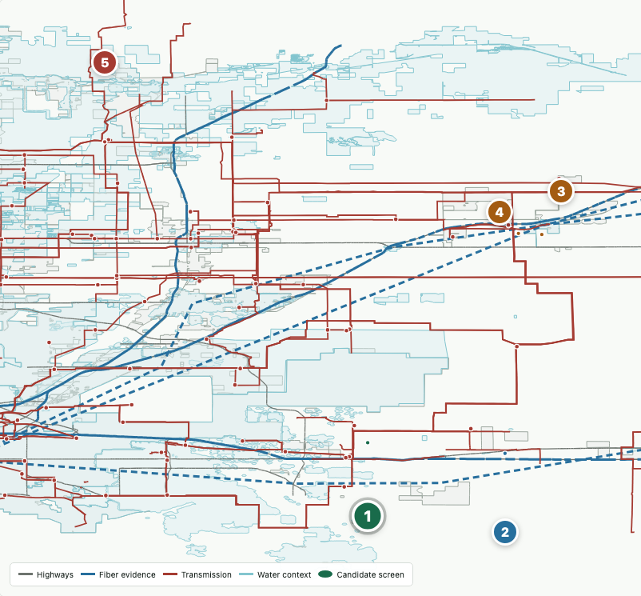
PUBLIC-EVIDENCE SITE SCREENING
AI Infrastructure
Site Intelligence
A corridor-scale demonstration for the eastern Denver metro: Watkins and Bennett north through Hudson and Keenesburg.
The system identifies where public geometry is promising, then makes the missing proof impossible to overlook.
Notes:
Open with the distinction between a screening system and a site-selection conclusion. This deck shows a working public-evidence product, not a claim that any parcel is viable.
[Sources]
- data/outputs/showcase/ai_infrastructure_site_intelligence.html
[/Sources]

Slide 2
The build is now a defensible decision screen
02
The current product combines corridor rankings, policy-aware parcel review, and a deliberately conservative evidence boundary.
100
35
0
ranked corridor parcels
Weld policy audits
sites proven viable
Five representative profiles translate the larger queue into a shareable demonstration without exposing owner names, parcel identifiers, or direct coordinates.
Notes:
Emphasize that zero proven sites is a design feature, not a weakness: the tool keeps public proximity separate from utility, carrier, entitlement, water, and site-control proof.
[Sources]
- docs/external-showcase.md
- docs/scoring-model.md
- docs/weld-data-center-policy-audit.md
[/Sources]

Slide 3
Three evidence stages prevent false confidence
03
1
2
3
Public geometry
Policy overlay
External proof
Parcel scale
Transmission + substations
Fiber corridor evidence
Highways + water context
Zoning eligibility
Rezoning or special review
Municipal boundaries
Community + aviation context
Electric will-serve + studies
Carrier routes + diversity
Water + wastewater capacity
Entitlement, title + control
Decision rule: advance only when the next evidence gate is specific, proportionate, and capable of changing the answer.
Notes:
Walk left to right. Public geometry creates a repeatable search; policy can stop an otherwise attractive parcel; only external evidence can support a real development conclusion.
[Sources]
- docs/fatal-flaw-rubric.md
- docs/scoring-model.md
[/Sources]

Slide 4
The corridor thesis survives, but parcel outcomes diverge
04
What the map supports
Aurora East: front review
Aurora East: comparison
Keenesburg: policy holds
Weld: site-control hold
The corridor contains several strong public infrastructure relationships. None of them proves capacity, service, entitlement, legal access, or market availability.
Notes:
Use the map as evidence of a coherent search area, not as a recommendation map. The representative profiles intentionally show different outcomes from similar-looking physical geometry.
[Sources]
- data/outputs/showcase/ai_infrastructure_site_intelligence.html
- docs/priority-corridor-zone.md
[/Sources]

Slide 5
Five profiles make the current decision logic tangible
05
Screen
Scale
Public evidence signal
Current gate
Aurora East A
493 ac
Recorded 76-acre data-center site inside broader screen
Title/tax-parcel crosswalk and legal access before provider verification
Aurora East B
512 ac
Strong fiber/highway; weaker power lead
Decide whether the power path merits utility confirmation
Keenesburg North A
318 ac
Useful power, fiber, and water geometry
Confirm boundary and controlling land-use code
Keenesburg South A
294 ac
Strong physical geometry
Agricultural zone prohibits use; test rezoning path
Weld Industrial Context
628 ac
I-3 path and direct power context
Establish market availability before further diligence
Names are sanitized. Owner names, parcel identifiers, and direct coordinate links are excluded from the external view.
Notes:
These five screens are illustrative, not a top-five recommendation. Aurora East A now includes verified public-record evidence of a 76-acre data-center land transaction inside the broader review envelope; it still does not establish capacity, service, entitlement, or viability.
[Sources]
- docs/external-showcase.md
- docs/first-parcel-record-chain.md
[/Sources]

Slide 6
Policy can overturn an attractive infrastructure score
06
Boundary first
Keenesburg-labeled parcels
A small municipal overlap does not establish jurisdiction. Confirm the controlling boundary and code.
Rezoning first
Unincorporated Weld A zone
Current policy prohibits data-center use in A zoning. A credible industrial rezoning path is the first gate.
Control first
Weld I-3 context
A policy path may exist, but utility ownership or unavailable land can end the opportunity before engineering spend.
Operating principle: policy and jurisdiction gates come before utility outreach, owner outreach, or paid technical work.
Notes:
This is the central decision insight. In Weld County, Ordinance 2026-01 materially changes the interpretation of the parcel ranking. Hudson status must also be confirmed before any parcel is treated as eligible.
[Sources]
- https://www.weld.gov/Newsroom/2026-News/Weld-County-Commissioners-approve-addition-of-data-centers-to-code
- https://hudsonco.gov/AgendaCenter/ViewFile/Agenda/_07012026-763
- https://www.townofkeenesburg.com/departments/planning_and_zoning/index.php
[/Sources]

Slide 7
Credibility depends on an explicit proof boundary
07
Demonstrated now
Requires external proof
Repeatable parcel and corridor geometry
Electric capacity, deliverability, schedule, and upgrade cost
Public power, road, water, and fiber proxy layers
Carrier route, splice access, diversity, and commercial terms
Policy-aware zoning and jurisdiction holds
Water and wastewater capacity or provider willingness
Traceable next gate for each representative screen
Entitlement outcome, title, easements, and legal access
REGIONAL PLANNED FIBER
Owner interest, site control, and investment viability
Weld
7 projects / 1,086 estimated miles
Elbert
1 project / 44 estimated miles
Public evidence is strong enough to prioritize diligence, not strong enough to substitute for it.
Notes:
This is the slide to use when someone asks whether the tool has found a buildable site. The honest answer is that it has found a structured queue of evidence questions and several representative screens worth targeted verification. The Colorado BEAD figures count fiber projects whose names match the county and sum their estimated aerial and buried miles. They provide planned regional context only. They do not identify routes, construction status, parcel serviceability, splice access, carrier diversity, or capacity, and they do not affect parcel scores.
[Sources]
- https://broadband.colorado.gov/funding/benefit_of_the_bargain
- https://www.arcgis.com/sharing/rest/content/items/7bc90780d52c4eef8cc43a2b870e7fb0
- data/outputs/fiber/colorado_bead_corridor_projects.csv
- docs/colorado-bead-fiber-expansion-evidence.md
- docs/fatal-flaw-rubric.md
[/Sources]

Slide 8
NEXT MILESTONE
A smaller, better-verified queue
Decision discipline
Advance only the front-review profile and one comparison case through parcel-level map review. Then seek narrow evidence in this order:
No paid spend until policy and map gates pass.
No capacity, service, entitlement, or viability claims without provider or agency evidence.
Park weak cases early and document why.
01
Jurisdiction + land-use path
02
Power relevance + utility intake
03
Fiber routes + water/service strategy
AI Infrastructure Site Intelligence
Notes:
Close with a practical ask: use the demonstration to align on the evidence sequence, then advance only the smallest set of cases that can justify external verification. The objective is to reduce false positives and wasted diligence spend.
[Sources]
- docs/executive-decision-queue.md
- docs/remaining-roadmap.md
[/Sources]

